Slide 1


Chowgacha-Jhenaidah model is the best example of community participation
Dr. Md.Emdadul Haque
Ex Senior Consultant (Obs&Gyne)
Jhenidah Sadar Hospital

Slide 2
A Hospital with a Vision …
Maximum utilization of Govt.
resources with
honesty and sincerity.
Integrated approach of
Administration, Community
Leaders .
Providing Effective services
through improved
management system.

Slide 3





CHOWGACHA UHC-Through the Ages
Old UHC
Old UHC
31-bedded UHC
50-bedded UHC

Slide 4
Background History Contd.
November 2000 started Comprehensive EOC program
April 2007-Demand Side Financing (DSF) program started.
Hospital declared as model health complex on 20 June 2008 and upgraded to 50 bedded hospital by MOH&FW.
“Chowgacha health complex Model is replicable through out the country” Declared by Dr. Margaret Chan, D.G. WHO on 8th March 2010.
Piloting to replication C-J model launched in 10 district hospital by HEU of MOH&FW in 2016.
Prime minister's office issues order to replicate the model throughout the country in2017.
DGHS started to replicate C-J model in all upazilla UHC & DH in june 2018.

Slide 5
Background History of Chowgacha Health Complex Model, Jessore
Basically started in 1995.
Effectively started in Feb. 1996.
From January 1995 to 1997 JICA helped by Frontline MCH Program by giving technical and logistic supports.
Since 1998 DGHS & UNICEF have continued the support.
<4 Special activities>
ANC-Corner
Basic EOC service
Under 5 corner for under 5 children
Monthly birth and death record

Slide 6


Blood donation program stared in 16 December, 1996 in Chowgacha UHC
A seminar on ‘Importance of birth & death registration and prevention of early marriage’ at Chowgacha Degree College in June, 1997. DC Jessore was the chief guest.

Slide 7




Beautification of the Premises

Slide 8


Citizen Charter

Slide 9

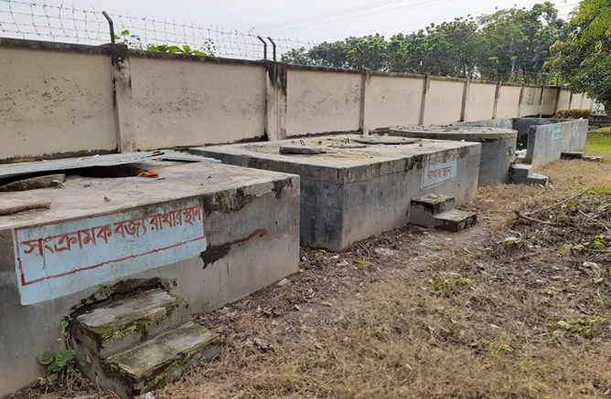
Innovations of Chowgacha Health Complex
Cycle stand near the entrance
Developed Waste Management System

Slide 10
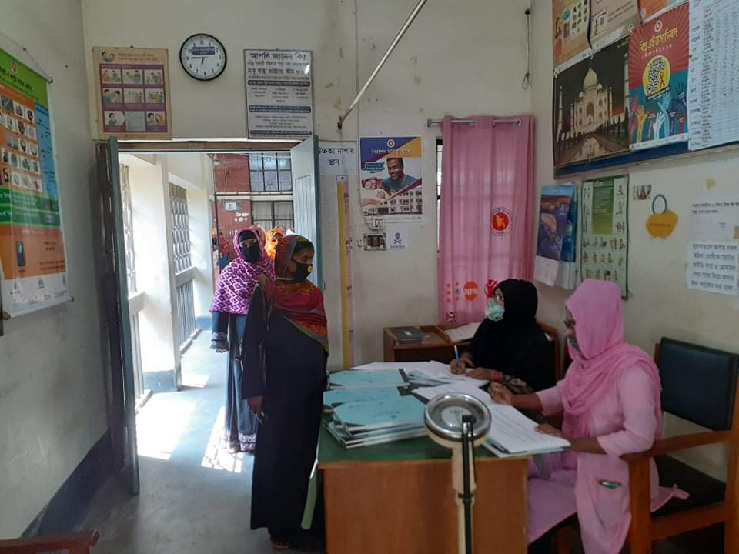
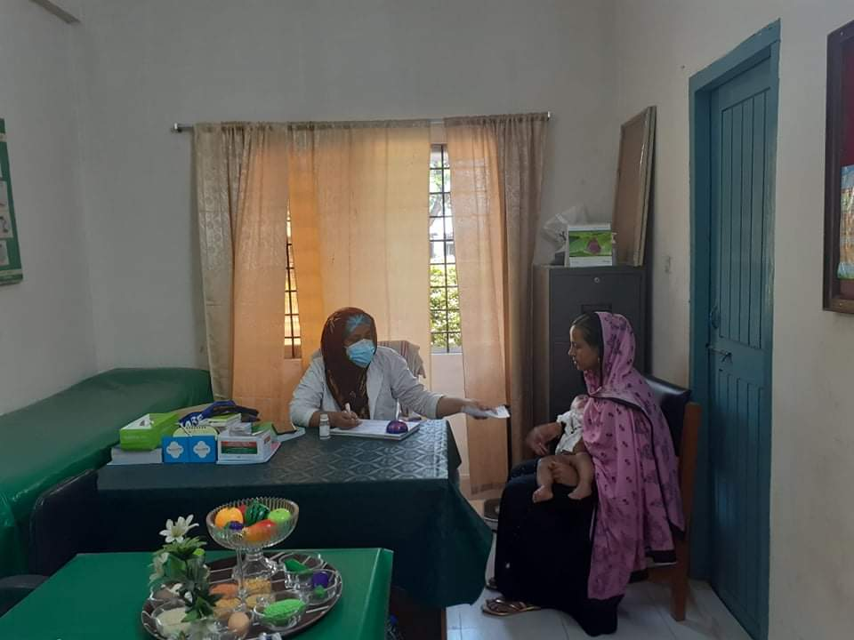
Daily Activities
ANC Corner
IMCI corner

Slide 11
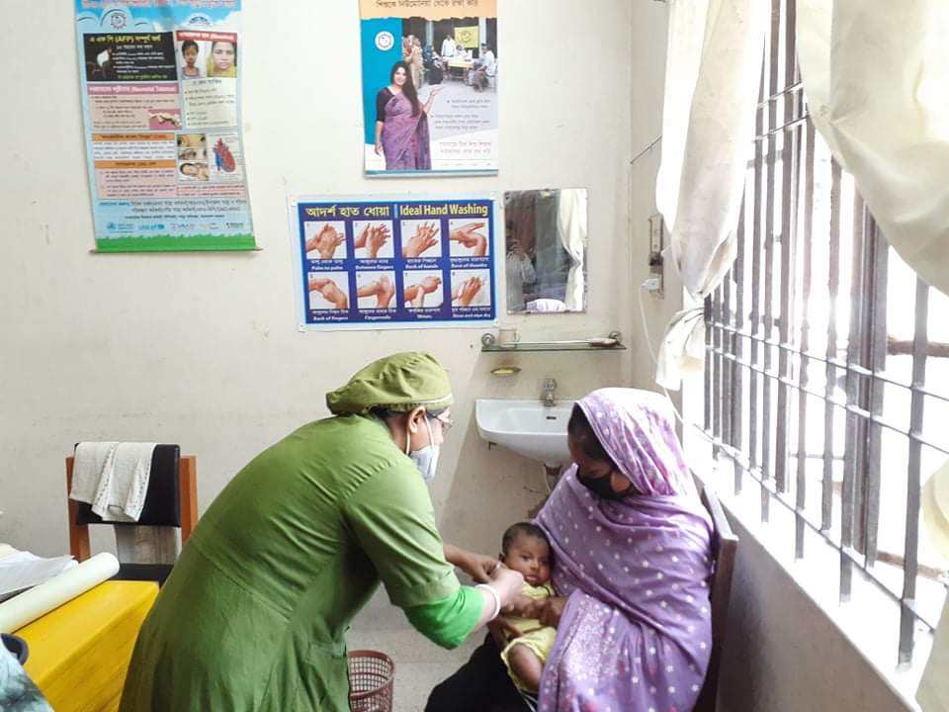
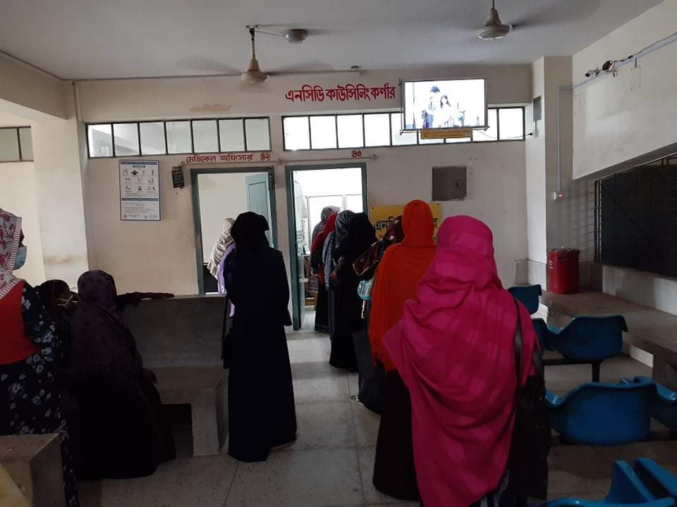
Daily Activities
Breast feeding & EPI Corner
NCD Corner

Slide 12
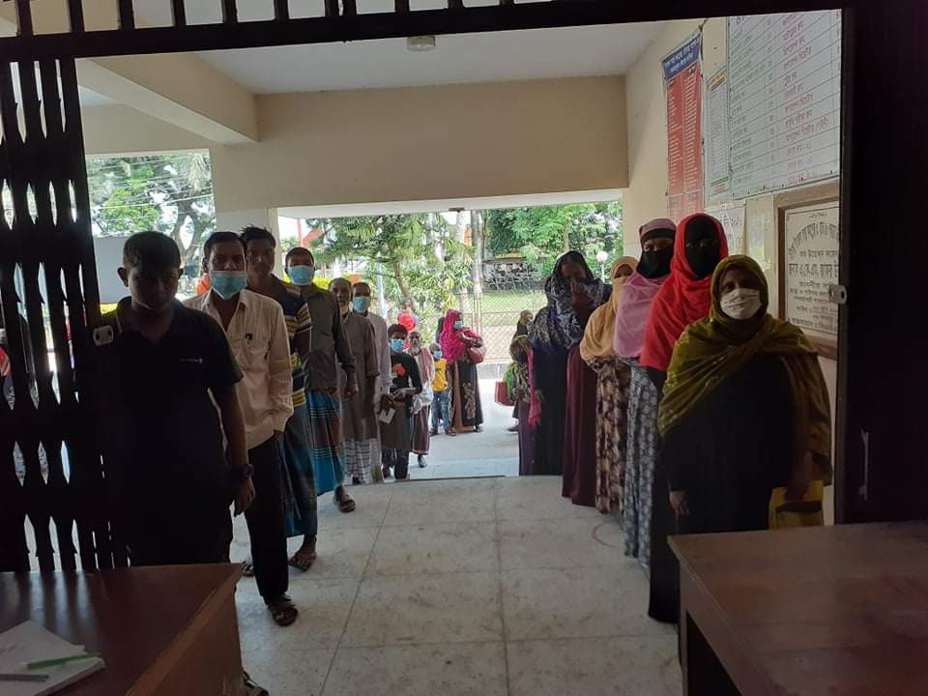
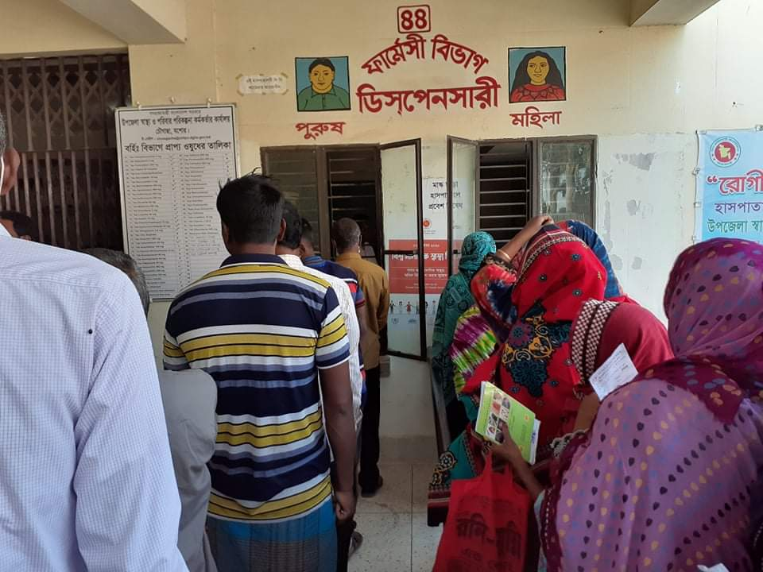
Daily Activities
Separation of male and female patients in Outdoor
Dispensary with separated male and female

Slide 13


Daily Activities
Labour Ward with 41=(11+30) beds
Rest room for pregnant mothers

Slide 14
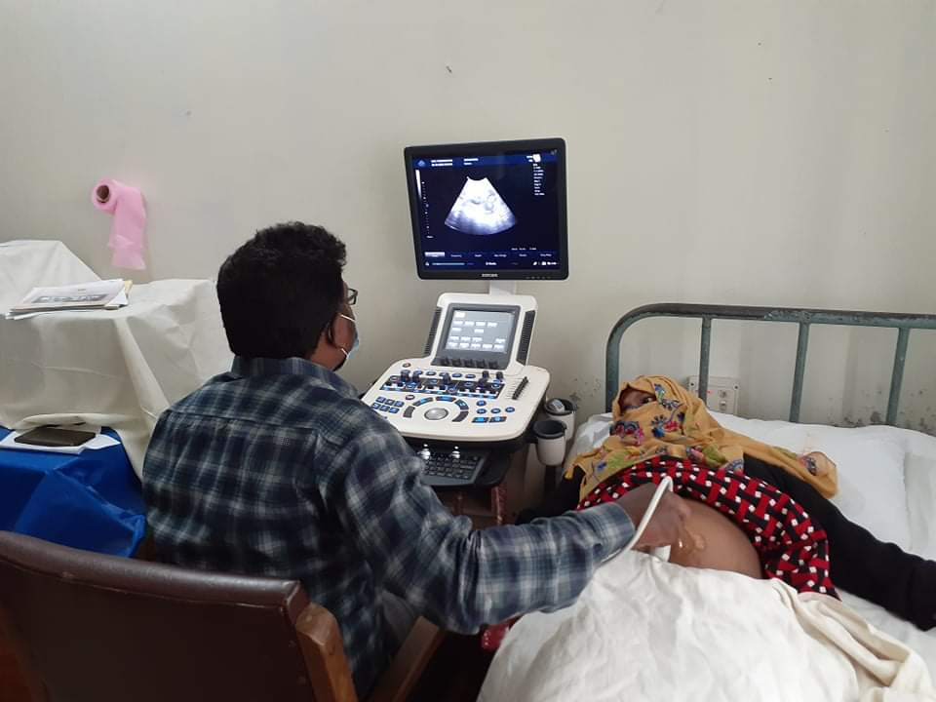
Community Participation
Ultrasonography machine donated by the Upazila Porishod

Slide 15




Community Participation

Slide 16
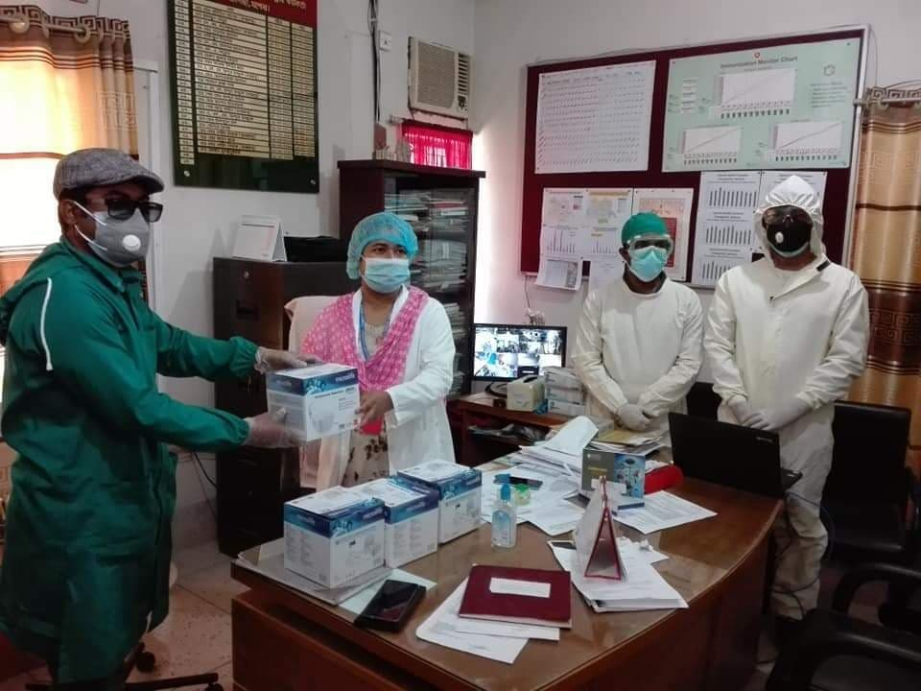
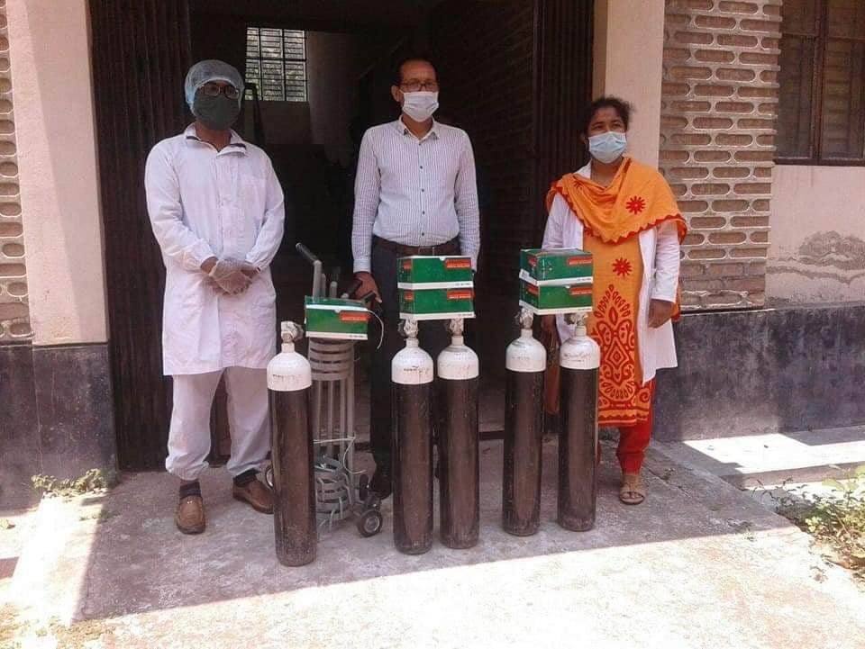
Community Participation
Nebuliser donated to the hospital by Upazila Porishod
Oxygen Cylinders donated by Upazila Porishod

Slide 17
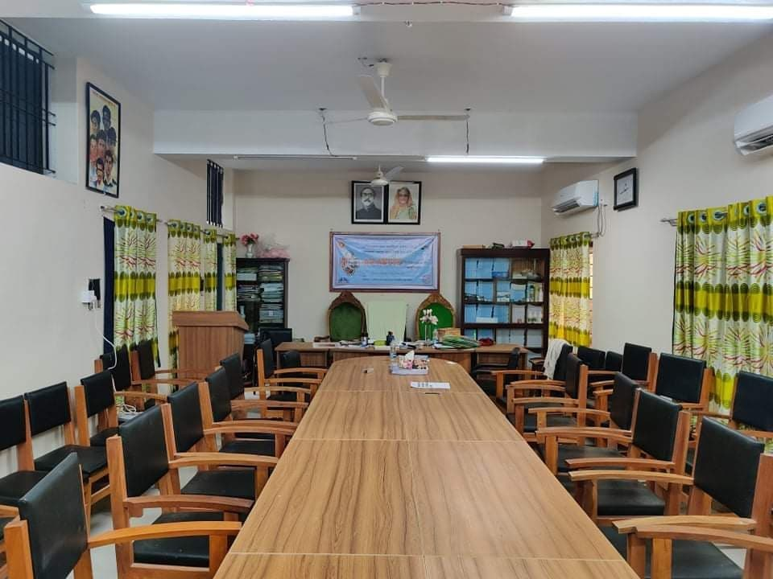
Newly Decorated Conference Room

Slide 18


Visit by Dignitaries – UHC Chowgacha
Honorable Health Minister Prof Dr. Ruhul Haque
MP with WHO Representative handing over
money and gift of voucher scheme of DSF
Secretary of MOHFW A.K.M. Zaforullah Khan
declared “Chowgacha UHC model” in DSF
voucher distribution ceremony on 20 June-2008

Slide 19

Upazila Health Complex
CHOWGACHA , JESSORE.
EOC Activities : 1997- 2011 (Hospital Delivery )

Slide 20

Upazila Health Complex
CHOWGACHA , JESSORE.
EOC Activities : 2000 - 2011 (Caesarian Section)

Slide 21
EOC Activities : 2011- 2020 (Total Hospital Delivery & C-section )

Slide 22
Emergency + Outdoor & Indoor 2011-2020
UHC Chowgacha

Slide 23
EOC Activities Chowgacha UHC 2011-2020
EOC Activities : 2011 – 2020 (ANC First Visit)

Slide 24
Upazilla Health Complex
CHOWGACHA , JESSORE.
COMMUNITY SUPPORTED MANPOWER
TOTAL :46
  Volunteers :26
  Cleaners & guards :16
  Others :04
  The remunerations come from
  Outsourcing :25
  Service provider :21
  The amount of remuneration ranging from 200/= To 8000/=tk. Per month depending upon the style of work, which costs a total of nearly 90,ooo/=Tk per month.

Slide 25






Slide 26
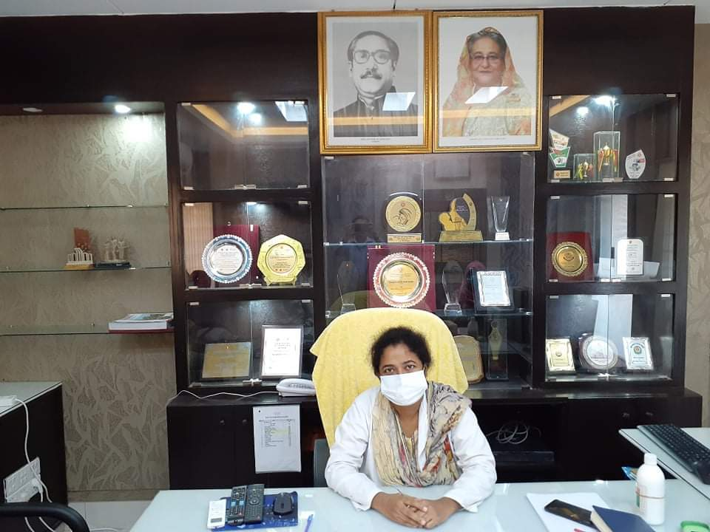
ACHIEVEMENTS of CHOWGACHA HEALTH COMPLEX
In 2008, Chowgacha Health Complex declared as the Model Upazilla Health Complex
  Chowgacha UHC achieved MDG target in 2009
  Chowgacha UHC became the Best EOC center with 98.4% delivery rate in 2011
  Chowgacha Health complex is awarded for best performance in EOC form 2005 to 2014
  Achieve Health Ministers Award for its best performances in 2017 and 2018
  The UHC starts upgrade to 100 bedded hospital
  The UHC model is being replicated throughout the country by DGHS, MOH & FW since 2016 by the order of Prime Ministers office

Slide 27

100 kh¨v wewkó m`i nvmcvZvj, wSbvB`n

Slide 28
Comparative data of health facilities of different country of the world
SL NO | Country | Per capita health Expenditure per year by Govt. ($) | Doctors per 10000 Population | Nurse per 10000 Population | Beds per 10000 population | Out of pocket expenditure
01 | USA | 10246 | 29 | 119 | 29 | 11.08
02 | UK | 3860 | 28 | 82 | 25 | 14.79
03 | Malaysia | 384 | 15 | 35 | 19 | 36.67
04 | Sri Lanka | 159 | 10 | 21 | 41 | 38.43
05 | India | 69 | 7. | 17 | 5.3 | 65.06
06 | Nepal | 48 | 7.5 | 31 | - | 60.41
07 | Pakistan | 45 | 9.8 | 7 | 8 | 66.49
08 | Bangladesh | 37 | 5.3 | 4 | 8 | 67
World Bank 2018

Slide 29
Challenges of the hospital in 2012
Insecure hospital environment.
Performance of all activities was very low.
Very limited support staff.
Receiving money from the patients by non-gov. staff.
Waste management system was poor.
Monitoring meeting was not performed regularly

Slide 30
Covid -19 Outcome Report - 2020-21

Slide 31

Emergency + Outdoor & Indoor Service 1998 to 2021
Emergency + Outdoor visit Indoor (admission)

Slide 32
Admitted Under 5 children in indoor from 2015 to 2021

Slide 33
Bed Occupancy Rate from 1998 to 2021

Slide 34

Operation Service (Major) 2012 to 2021

Slide 35
Total ANC and Delivery in Jhenaidah District Hospital 2011-2020

Slide 36

EOC performance 2015 to 2021

Slide 37

5 Best Performing EOC District Hospital in Khulna Division - 2021
C-Section, NVD, Total Delivery

Slide 38
Comparative data of revenue income (in Taka) from 2015 to 2021
Increase( +) 15,23,345

Slide 39
Community Support System in Sadar Hospital
53 manpower (Cleaner 20, Ayah & ward boy 21, Guard 6, Volunteer 3, Trolley man 3 ) is supported by the community.
MP of Jhenaidah-2 donated 14 manpower support.
Chairman of Zahedee foundation supports 10 manpower and an intercom with a cost of nearly two lac taka.
Mayor of Jhenaidah Paurasava plays an important role in security , cleanliness, repaired the boundary wall and supports 5 man power and renovation of pediatric word and donation of a biochemistry analyzer at a cost of 1,15,000 Taka.
Retired secretary donated a generator for 24 hours OT service with a cost of nearly 33 thousand taka.
Former-chairman of Jhenidah Pourosova supports 2 manpower
Doctors of the hospital and Jhenaidah town supports 17 man power.

Slide 40




Visit to Shatkhira District Hospital and Introduction of TQM activities

Slide 41




Changes in EOC Ward
Before
After
Before
After

Slide 42








Changes in Surgery & Pediatric Word

Slide 43




Waste Management & Campus Protection
Before
After
Before
After

Slide 44




Use of color code, alignment of picture & continuous big cleaning day
Color code
Color code
Alignment of pictures

Slide 45



Innovation in Medicine Ward

Slide 46




Innovative activities of Jhenaidah Sadar Hospital - 1
Reception room
Creation of nursing aid
Health education session
Community engagement

Slide 47




Innovative activities of Jhenaidah Sadar Hospital - 2

Slide 48




Involvement of district high officials in hospital activities

Slide 49



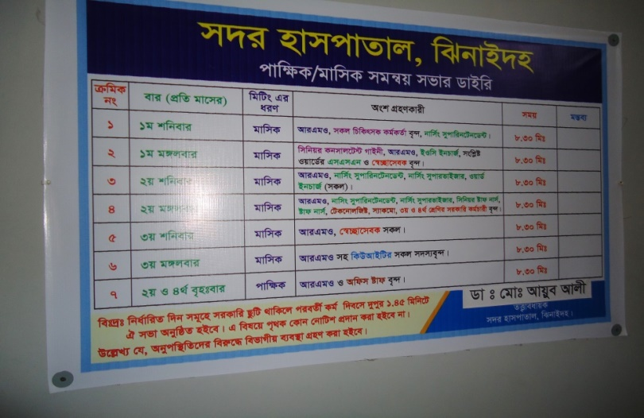
Internal Monitoring System
Meting of health improvement committee
Meting of community support group committee
QIC meeting
Monthly meeting schedule

Slide 50




Improved pediatric word by local initiative

Slide 51




Community participation during covid-19 management

Slide 52

সদর হাসপাতাল,ঝিনাইদহ

Slide 53
Achievement of the Hospital
1. Active Community Participation in health service is an example in Bangladesh.
2. Improved performance of all services specially Pediatric, obstetric, operation
and outdoor service.
3. Improved Cleanliness and Beautification of Campus.
4.. The hospital is awarded 7 times from 2013 to 2019.
5. Improved Security.
6. Improved Financial Management
7. Replication of C- J Model by DGHS in 20 District hospital & 40 UHC of the country.
8. Nearly 70 lacks Taka support for 6 high flow oxygen nasal cannula, central oxgen supplying system , a pic up for covid patient

Slide 54

HSSI Health Minister’s National Award 2019

Slide 55

Thank You
আমাদের বাগানের ফুল
Notes:
55

Slide 56
Reason why Chowgacha Health Complex is Model-1
Successful leadership in health management
All the Components of Primary Health Care are successfully implemented here
Personal and group skills in health care
Community engaged health management
Optimum use of government resources
Effective relation with local administration and with other government organizations
Improvement of security by community engagement
Improved maternal and child health care activities
Ensuring corner-based health care
Woman and Baby Friendly Hospital.

Slide 57
Reason why Chowgacha Health Complex is Model-2
Birth and death recording, progress assessment and accountability by collecting information on all health indicators
Improving healthcare by unit management
Health awareness by health education in outdoor, indoor, ante-natal registration room and pregnant women restroom
Cleanliness (Waste management) and beautification of the facility and premises
Provision of safe blood transfusion for emergency needs
Zero tolerance against corruption
Implementation of the 5S KAIZEN-TQM for the improvement of health care
Improved financial management by establishing cash counter

Slide 58
Covid-19 Admitted Patient Report 7/5/20 to 31/12/2021

